Slide 1






Enabling Value-Based Care
Microsoft Fabric & Power BI
Streamline Healthcare Quality Measurement with dQMs, CQL & FHIR – Automate, Standardize, and Improve Accuracy!
Hans Esquivel
Consultant| Analytics & AI

Slide 2

Innovative Approach
Our mission is to transform healthcare quality measurement with dQMs, CQL, and FHIR—automating accuracy, standardizing data, and ensuring seamless interoperability.
Reduce manual effort
Enhance reporting precision
Drive better patient outcomes with a smarter, data-driven approach

Slide 3
Overview of dQMs and CQL, and the Role of FHIR
The Meaningful Use (MU) program has evolved into the Promoting Interoperability (PI) Program for hospitals and the Merit-Based Incentive Payment System (MIPS) PI category for eligible providers under CMS’s Quality Payment Program (QPP). However, concepts like Data Quality Measures (DQMs) and Clinical Quality Language (CQL) still play roles in reporting electronic clinical quality measures (eCQMs) under these programs.
eCQMs and CQL
  eCQMs remain a required reporting component for hospitals (under PI) and providers (under MIPS).
  CMS requires eCQMs to be written using CQL to standardize measure logic.
Data Quality Measures (DQMs)
  CMS has introduced DQMs as a potential future evolution of quality measures, aiming to assess data quality more explicitly.
  While not a mandatory part of PI/MIPS today, CMS is exploring DQMs in pilot programs.
Promoting Interoperability (PI) Requirements
  Hospitals and providers must still submit data for CMS PI programs, including eCQMs.
  For 2024 and beyond, CMS continues to emphasize certified electronic health record technology (CEHRT) and adherence to FHIR-based interoperability standards.
While CQL-based eCQMs are still required, DQMs are not yet a required component but are expected through CMS in the future interoperability initiatives.

Slide 4
…Overview of dQMs and CQL, and the Role of FHIR
dQMs (Digital Quality Measures)
  Digital Quality Measures are standards-based, machine-readable specifications for measuring healthcare quality. They are designed to reduce manual effort, improve interoperability, and enhance the accuracy of quality reporting.
  dQMs leverage standardized data formats, structured data sources, and electronic health records (EHRs) to automate and streamline the measurement process.
CQL (Clinical Quality Language)
  CQL is a human-readable and machine-interpretable language used to express logic for clinical decision support (CDS) and electronic clinical quality measures (eCQMs).
  CQL enables standardized logic across various use cases and systems, improving consistency and reducing ambiguity in quality measure definitions.
FHIR (Fast Healthcare Interoperability Resources)
  FHIR is a standards framework that facilitates the exchange of healthcare information across systems. It defines resources and APIs for retrieving, storing, and sharing clinical data.
  In the context of dQMs, FHIR plays a critical role by providing the data infrastructure and standardization required to extract, compute, and share measure results.
  FHIR-based measures leverage FHIR resources (e.g., Patient, Encounter, Condition) to retrieve and compute quality metrics, ensuring data consistency and interoperability across systems.

Slide 5
Advantages of dQMs vs Current Approaches
Current Challenges in Traditional Quality Measurement
  Manual Processes: Paper-based or semi-automated workflows are resource-intensive and error-prone.
  Fragmented Data: Data is often siloed across different systems, making aggregation and standardization difficult.
  Lack of Real-Time Reporting: Current measures often rely on retrospective data collection, which limits timely interventions.
  Complexity and Ambiguity: Proprietary formats and inconsistent definitions increase the complexity of implementing quality measures.
Advantages of dQMs
  Automation: dQMs use structured, standardized data (e.g., FHIR) to reduce manual data abstraction.
  Interoperability: Leveraging FHIR ensures seamless data sharing across systems, enabling a unified view of patient care.
  Real-Time Analytics: dQMs can enable near real-time quality measurement, improving responsiveness and care outcomes.
  Consistency: Using CQL ensures logic is expressed consistently across systems and use cases.
  Scalability: Automated and standardized approaches make it easier to scale measurement programs across organizations and regions.
  Cost Efficiency: Reducing manual processes lowers administrative burdens and associated costs.

Slide 6
Key Roadblocks and Critical Considerations for Implementation
Roadblocks
Data Quality and Availability: Incomplete or inconsistent data in EHRs can limit the effectiveness of dQMs.
Interoperability Challenges: Not all systems are FHIR-compliant, requiring costly integration efforts.
Technical Complexity: Implementing dQMs involves transitioning from legacy systems to new standards, requiring investment in tools, training, and infrastructure.
Regulatory Compliance: Aligning dQMs with evolving regulatory frameworks can be complex.
Stakeholder Buy-In: Engaging providers, payers, and technology vendors to adopt dQMs requires clear demonstration of value.
Privacy Concerns: Ensuring compliance with data privacy laws (e.g., HIPAA) while enabling real-time data exchange.
Critical Considerations
Governance and Standards: Adopting widely accepted standards like FHIR and CQL to ensure consistency and compatibility.
Infrastructure Readiness: Assessing the technical capabilities of existing systems to support dQMs.
Training and Education: Equipping staff with the knowledge to implement and maintain dQMs effectively.
Stakeholder Engagement: Collaborating with clinicians, IT staff, and administrators to align goals and expectations.
Incremental Implementation: Gradual adoption, starting with pilot programs, to identify and address challenges early.

Slide 7





Solution Approach and Features
Identifying Gaps in Care
Enhancing Analytics
Enabling Value-Based Care
dQMs enable real-time analysis of patient data to identify gaps such as missed screenings or vaccinations.
Use Case: A dQM could flag diabetic patients who have not received their annual HbA1c test.
dQMs support advanced analytics by leveraging standardized data and logic to generate actionable insights.
Use Case: Aggregating population health data to assess trends and identify high-risk groups.
dQMs align with value-based care models by providing timely and accurate metrics on outcomes, utilization, and cost.
Use Case: Measuring the effectiveness of care coordination interventions for patients with chronic conditions.
Supporting Clinical Decision Support (CDS)
Regulatory Reporting and Accreditation
dQMs integrate with CDS tools to provide real-time feedback and alerts based on quality metrics.
Use Case: A dQM could trigger a CDS alert for a clinician to order preventive care for eligible patients during an encounter.
dQMs streamline compliance reporting for programs such as CMS’s Merit-based Incentive Payment System (MIPS).
Use Case: Automating reporting of quality measures for accountable care organizations (ACOs).

Slide 8
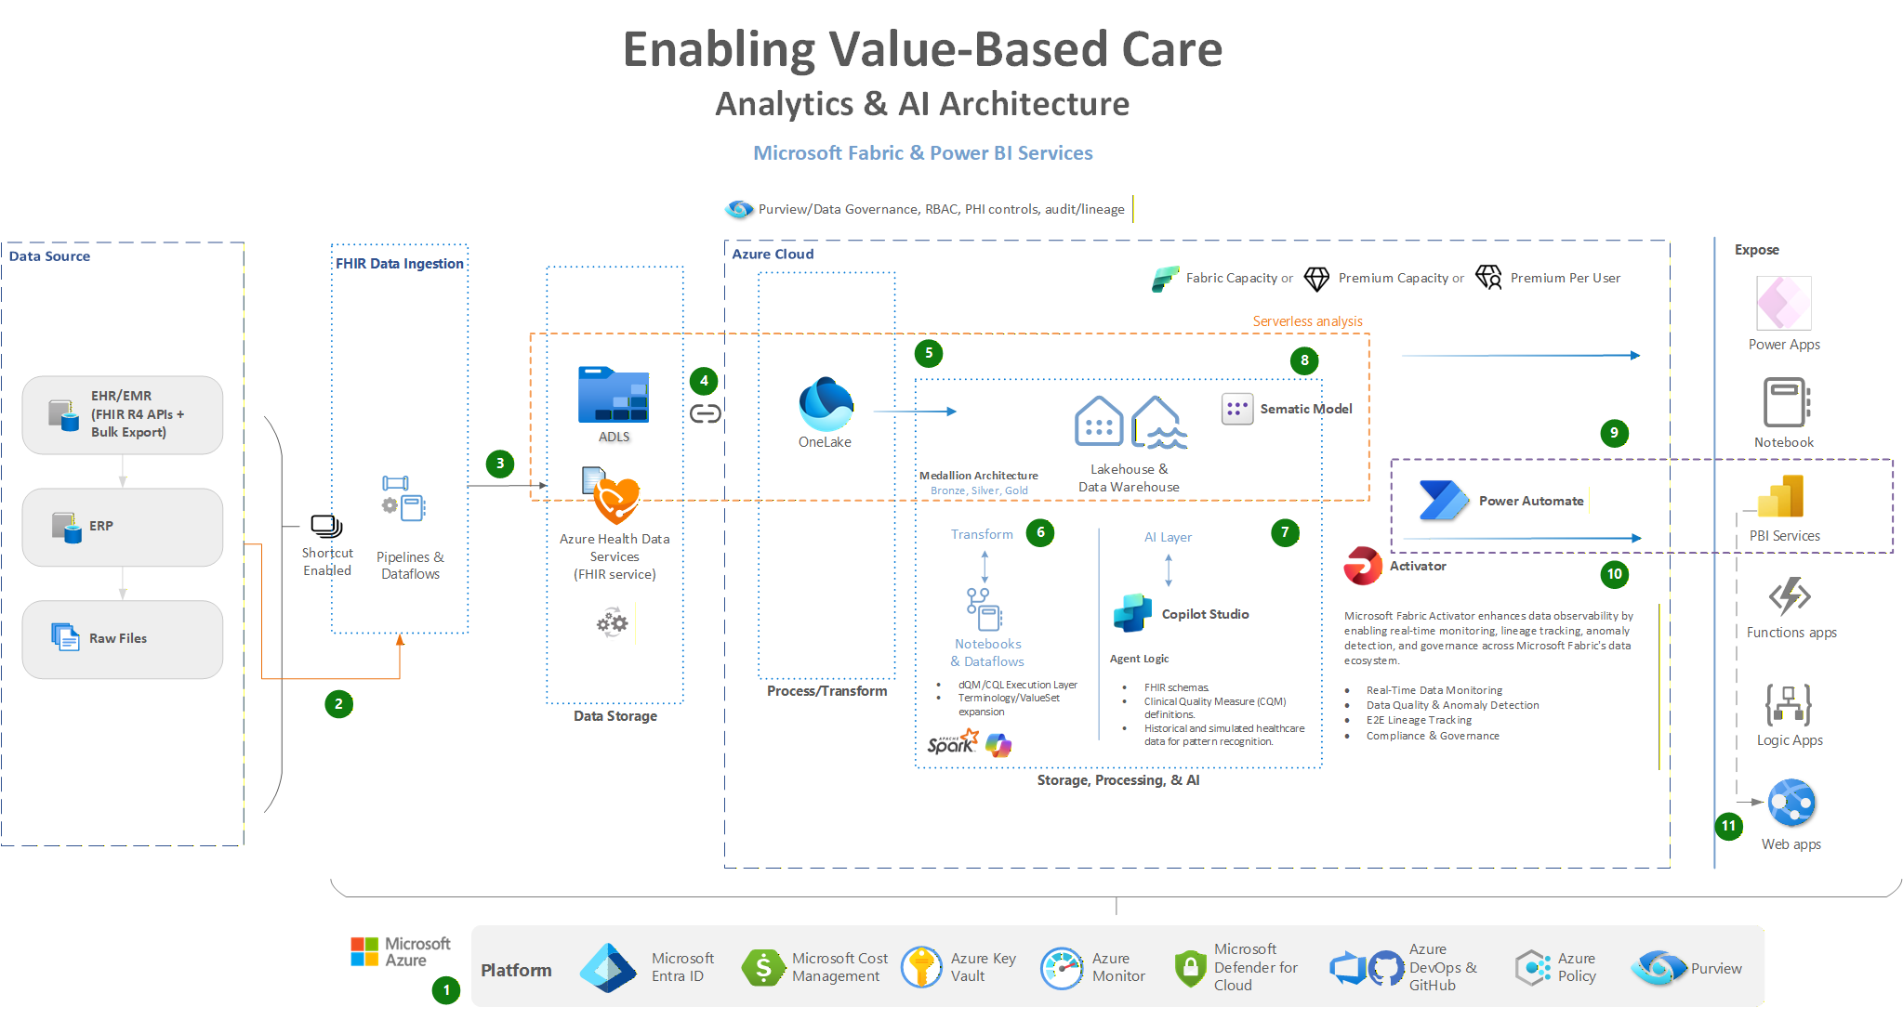

Slide 9
Key Milestones & Timeline
CQL Development & Adoption (2017-Present)
  2017: The Centers for Medicare & Medicaid Services (CMS) and the Office of the National Coordinator for Health IT (ONC) endorsed CQL as the standard for expressing electronic clinical quality measures (eCQMs).
  2019-2020: CQL became the official standard for eCQMs used in CMS quality reporting programs, replacing the earlier Quality Data Model (QDM)-based logic.
  2021-Present: Widespread industry adoption with continued refinement, aligning CQL with FHIR.
FHIR & dQMs Evolution (2020-Present)
  2020: The shift toward FHIR-based quality measurement began gaining traction with initiatives like the FHIR-based Quality Measure Implementation Guide (IG) developed by HL7.
  2021: CMS announced the move toward dQMs, emphasizing digital transformation in quality measurement.
  2022: CMS defined dQMs as measures leveraging FHIR-based interoperability standards, aiming to fully transition by the mid-2020s.
  2023: Continued pilot testing of FHIR-based dQMs in programs like MIPS, Hospital Quality Reporting, and ACO models.
  2024-2025: CMS is targeting full implementation of FHIR-based dQMs, replacing older eCQM formats.

Slide 10
Current State & Future Direction
FHIR-based dQMs are still in an implementation and refinement phase, with CMS, HL7, and healthcare organizations working to fully integrate them by 2025-2027.
CQL with FHIR is actively in use but continues to be updated for better alignment with evolving interoperability and quality measurement needs.
The push for automated, interoperable, and digital quality measures is driven by regulatory bodies (CMS, ONC, HL7), and healthcare organizations are encouraged to adopt these standards as part of their reporting and analytics infrastructure.

Slide 11
What’s Next for CQL and Quality Measures
Expanded FHIR Integration
  Further adoption of FHIR-based infrastructure will enhance the scalability and flexibility of dQMs.
Next-Generation Analytics
  Advancements in artificial intelligence (AI) and machine learning (ML) could leverage dQMs for predictive analytics and personalized interventions.
Broader Use Cases
  Beyond quality reporting, CQL and dQMs could support broader applications, such as research and public health initiatives.
Simplification of Standards
  Efforts to simplify and harmonize standards will make dQMs more accessible to smaller organizations.
Increased Interoperability Mandates
  Regulatory frameworks (e.g., TEFCA in the U.S.) are expected to push for greater interoperability, accelerating the adoption of dQMs.
Real-Time Quality Dashboards
  Emerging tools will offer providers real-time visibility into their performance on quality measures, driving proactive improvements.
Global Adoption
  As international standards converge around FHIR and CQL, dQMs could become a global benchmark for quality measurement.

Slide 12

Thank You!
Hans Esquivel
Consultant| Analytics & AI

